Slide 1
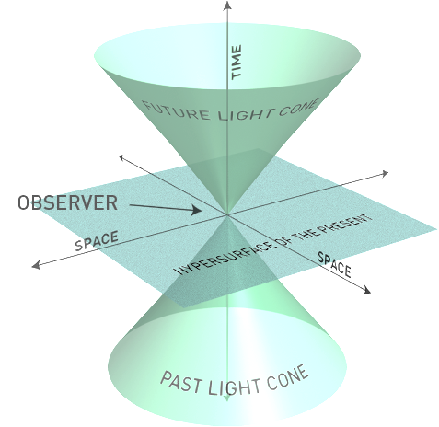
Further Logical Consequences of Einstein’s Postulates
Evan Claudeanos
March 31, 2014

Slide 2
Lecture Plan
The Relativistic Doppler Effect
Mass-Energy Equivalence
The Twin Paradox
Simultaneity and Coexistence
Philosophical Questions

Slide 3
The Relativistic Doppler Effect
Originally described by Christian Doppler in 1842.
Einstein corrects for time dilation.

Slide 4
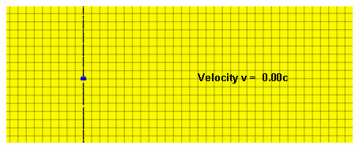
Wikimedia

Slide 5
The Relativistic Doppler Effect: Testable Predictions
Cosmological Distances
Stellar Wobble

Slide 6
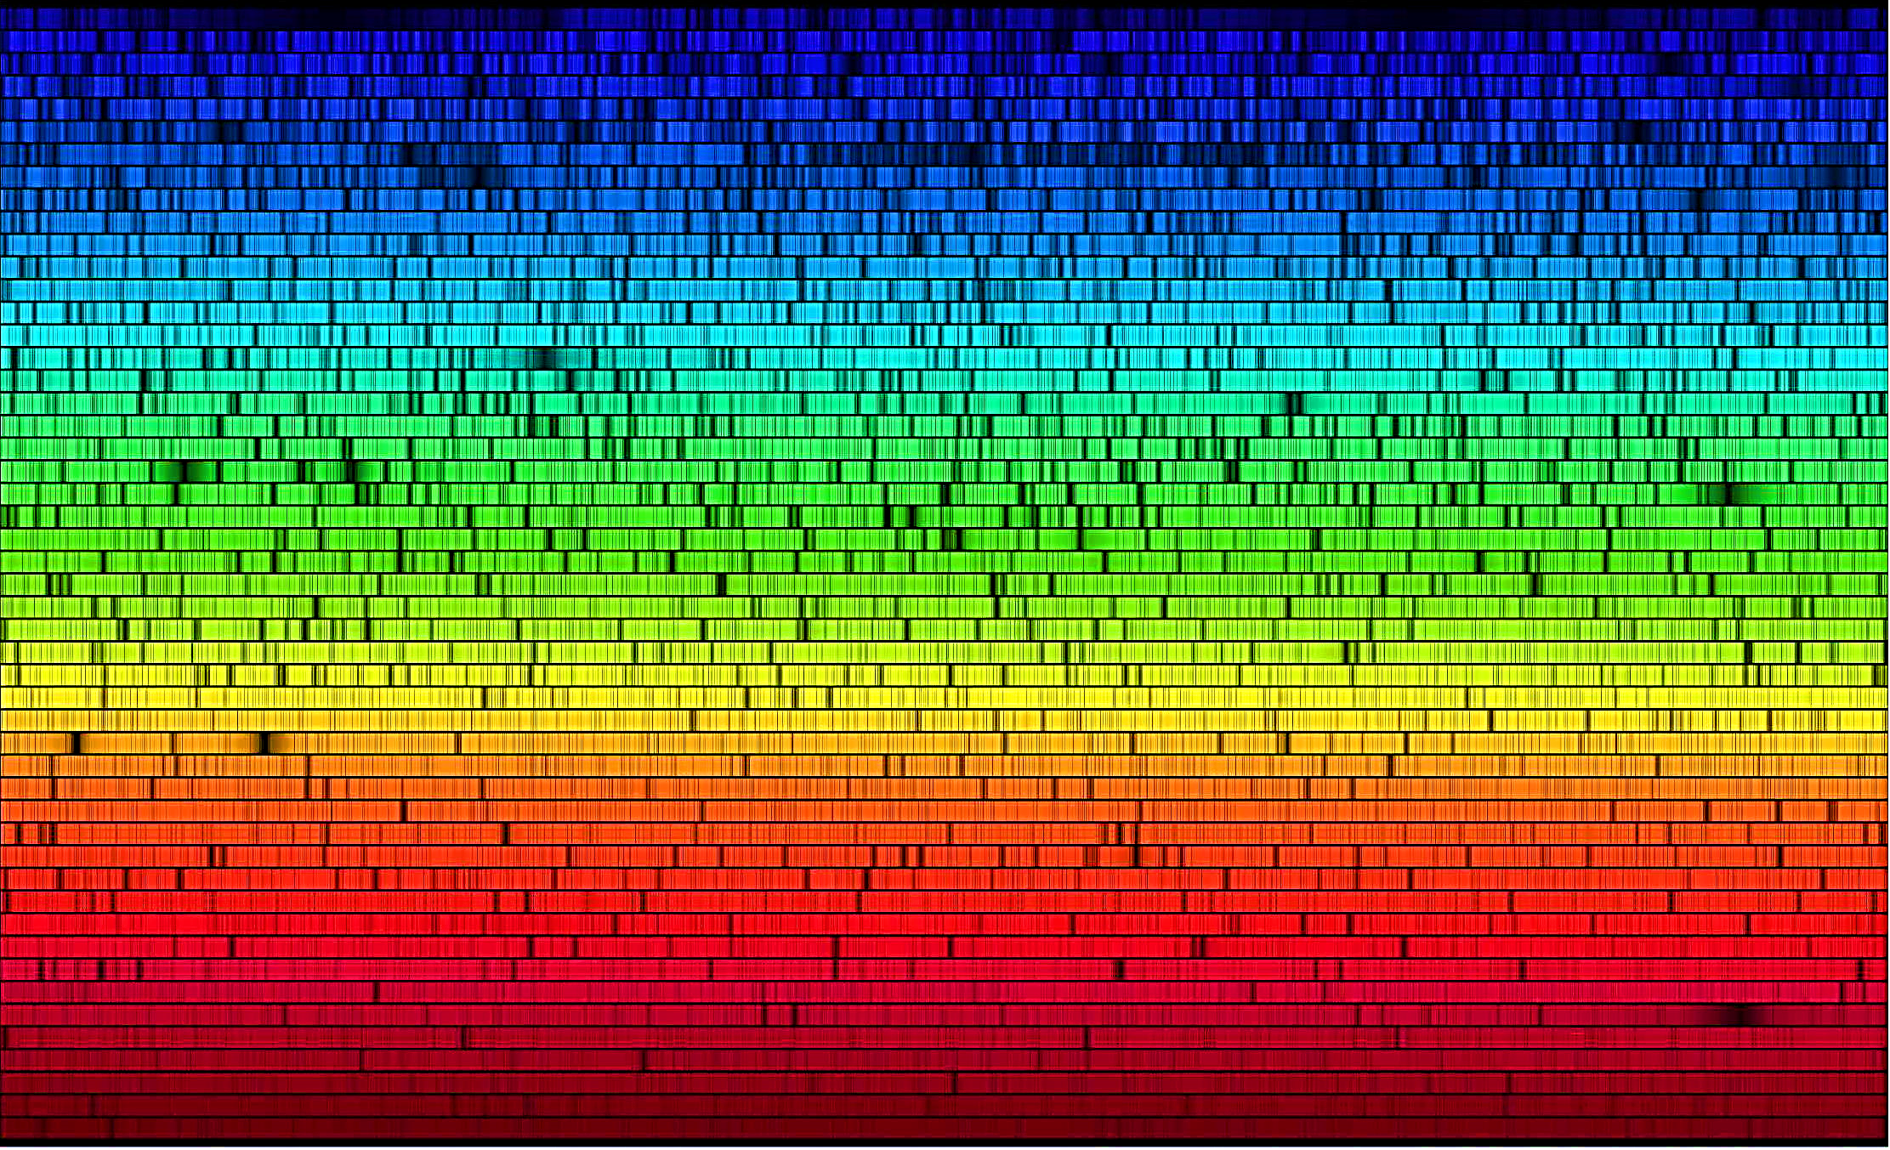
Harvard-Smithsonian

Slide 7
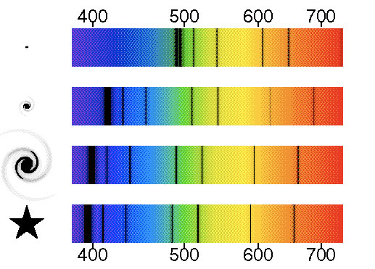
webexhibits.org/causesofcolor

Slide 8
European Southern Observatory

Slide 9
Mass-Energy Equivalence: Some Tools
Lorentz Transformations
Time Dilation
Doppler Shift

Slide 10
Mass-Energy Equivalence: Key Concepts
Measurements of the energy density carried by an electromagnetic wave depend on the observer’s frame of reference.
Measurements of the energy distribution of a changing system depend on the observer’s frame of reference.
A change in energy of a light-mitting source, as measured from two different reference frames, is due to a change in kinetic energy.
Given no change in velocity of a light-emitting source, its change in energy is due to a change in mass.

Slide 11
The Twin Paradox: Setup
Consider identical twins A and B. One takes off in a rocket, flies to Proxima Centauri, and returns to Earth.
What would we say about the twins’ relative ages if we assume symmetry between the reference frames of A and B?

Slide 12
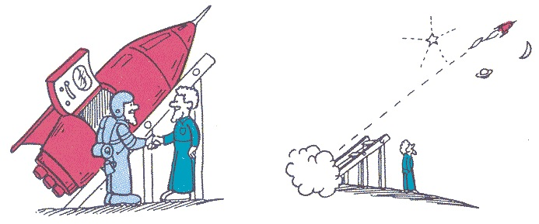
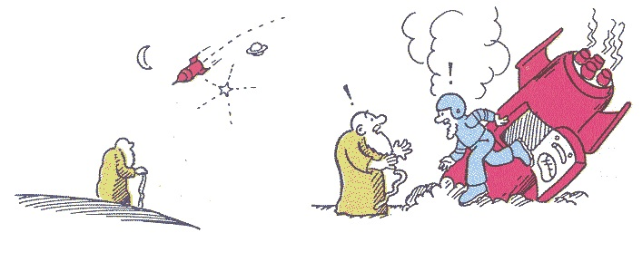

Slide 13
The Twin Paradox: Some Resolutions
Frame Asymmetry
Three Lorentz Frames
Signal Exchange

Slide 14
The Twin Paradox: Signal Exchange
Assume identical heart rates
Each twin measures own heart rate
Account for length contraction

Slide 15
Simultaneity and Coexistence
Two-event Minkowski space-time diagrams
Three-event Minkowski space-time diagrams

